Slide 1
Docker
with
run:ai
(and Jupyter)

Slide 2
Agenda

Slide 3
Outline

Slide 4
Outline
Docker intro

Slide 5
Outline
Docker intro
What is Docker?
Why use Docker?
What do I need to use Docker?

Slide 6
Outline
Docker intro
What is Docker?
Why use Docker?
What do I need to use Docker?
How do I make a Docker image?
How do I use my Docker image with Run:ai?

Slide 7
Outline
Docker intro
What is Docker?
Why use Docker?
What do I need to use Docker?
How do I make a Docker image?
How do I use my Docker image with Run:ai?
What is a Dockerfile?
About “layers”

Slide 8
Outline
Docker intro
What is Docker?
Why use Docker?
What do I need to use Docker?
How do I make a Docker image?
How do I use my Docker image with Run:ai?
What is a Dockerfile?
About “layers”
Docker images with Run:ai (using Jupyter example)

Slide 9
Outline
Docker intro
What is Docker?
Why use Docker?
What do I need to use Docker?
How do I make a Docker image?
How do I use my Docker image with Run:ai?
What is a Dockerfile?
About “layers”
Docker images with Run:ai (using Jupyter example)
Key concepts
Jupyter on Run:ai with mounted NFS

Slide 10
Outline
Docker intro
What is Docker?
Why use Docker?
What do I need to use Docker?
How do I make a Docker image?
How do I use my Docker image with Run:ai?
What is a Dockerfile?
About “layers”
Docker images with Run:ai (using Jupyter example)
Key concepts
Jupyter on Run:ai with mounted NFS
Docker image with non-interactive jobs
Running a non-interactive job

Slide 11
Outline
Docker intro
What is Docker?
Why use Docker?
What do I need to use Docker?
How do I make a Docker image?
How do I use my Docker image with Run:ai?
What is a Dockerfile?
About “layers”
Docker images with Run:ai (using Jupyter example)
Key concepts
Jupyter on Run:ai with mounted NFS
Docker image with non-interactive jobs
Running a non-interactive job
Closing notes

Slide 12
Outline
Docker intro
What is Docker?
Why use Docker?
What do I need to use Docker?
How do I make a Docker image?
How do I use my Docker image with Run:ai?
What is a Dockerfile?
About “layers”
Docker images with Run:ai (using Jupyter example)
Key concepts
Jupyter on Run:ai with mounted NFS
Docker image with non-interactive jobs
Running a non-interactive job
Closing notes
Some general Docker tips
BE AWARE

Slide 13
Docker intro

Slide 14
What is Docker?

Slide 15
What is Docker?
Docker is a way to create “images.”

Slide 16
What is Docker?
Docker is a way to create “images.”
Image have an OS (usually linux) and software installed on them

Slide 17
What is Docker?
Docker is a way to create “images.”
Image have an OS (usually linux) and software installed on them
Images can be run on any hardware as “containers”

Slide 18
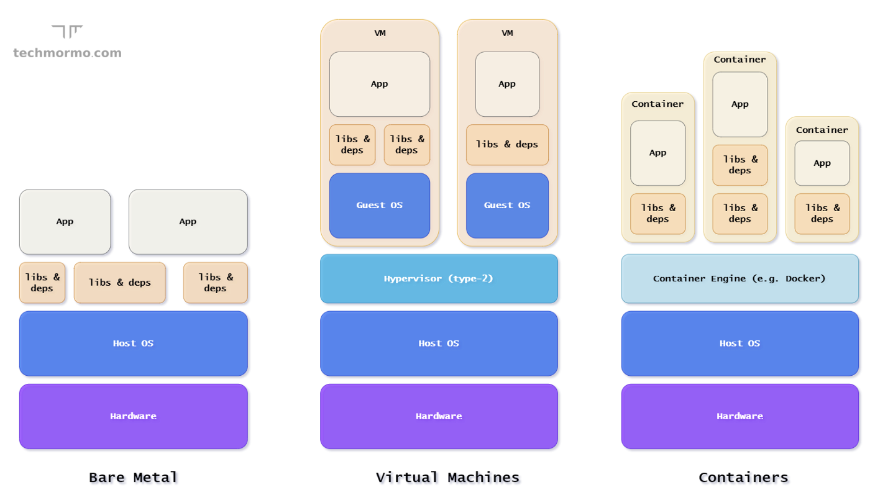
What is Docker?
Docker is a way to create “images.”
Image have an OS (usually linux) and software installed on them
Images can be run on any hardware as “containers”

Slide 19
What is Docker?
Docker is a way to create “images.”
Image have an OS (usually linux) and software installed on them
Images can be run on any hardware as “containers”

Slide 20
What is Docker?
Docker is a way to create “images.”
Image have an OS (usually linux) and software installed on them
Images can be run on any hardware as “containers”

Slide 21
Why use Docker?

Slide 22
Why use Docker?
User 1 Code
Requires
Cudatoolkit=11.2
Python=3.7

Slide 23
Why use Docker?
User 1 Code
User 2 Code
Requires
Cudatoolkit=11.2
Python=3.7
Requires
Cudatoolkit=11.7
Python=3.9

Slide 24
Why use Docker?
User 1 Code
User 2 Code
User 3 Code
Requires
Cudatoolkit=11.2
Python=3.7
Requires
Cudatoolkit=11.7
Python=3.9
Requires
Cudatoolkit=11.5
Python=3.8

Slide 25
Why use Docker?
User 1 Code
User 2 Code
User 3 Code
Requires
Cudatoolkit=11.2
Python=3.7
Requires
Cudatoolkit=11.7
Python=3.9
Requires
Cudatoolkit=11.5
Python=3.8
Image 1
Image 2
Image 3

Slide 26
Why use Docker?
User 1 Code
User 2 Code
User 3 Code
Requires
Cudatoolkit=11.2
Python=3.7
Requires
Cudatoolkit=11.7
Python=3.9
Requires
Cudatoolkit=11.5
Python=3.8
Image 1
Image 2
Image 3
Each user can create an image with the software they need installed on it…

Slide 27

Why use Docker?
… and simply run the image inside a container on any hardware with docker engine running.
User 1 Code
User 2 Code
User 3 Code
Requires
Cudatoolkit=11.2
Python=3.7
Requires
Cudatoolkit=11.7
Python=3.9
Requires
Cudatoolkit=11.5
Python=3.8
Image 1
Image 2
Image 3
Each user can create an image with the software they need installed on it…

Slide 28
Why use Docker?
… and simply run the image inside a container, on any hardware with docker engine running.
User 1 Code
User 2 Code
User 3 Code
Requires
Cudatoolkit=11.2
Python=3.7
Requires
Cudatoolkit=11.7
Python=3.9
Requires
Cudatoolkit=11.5
Python=3.8
Image 1
Image 2
Image 3
Image 1
Image 2
Image 3
Each user can create an image with the software they need installed on it…
User 1 Code
User 2 Code
User 3 Code

Slide 29
What do I need to use docker?

Slide 30
What do I need to use docker?
An image repository

Slide 31

What do I need to use docker?
An image repository
I use Docker hub.

Slide 32
What do I need to use docker?
An image repository
Docker software
I use Docker hub.

Slide 33
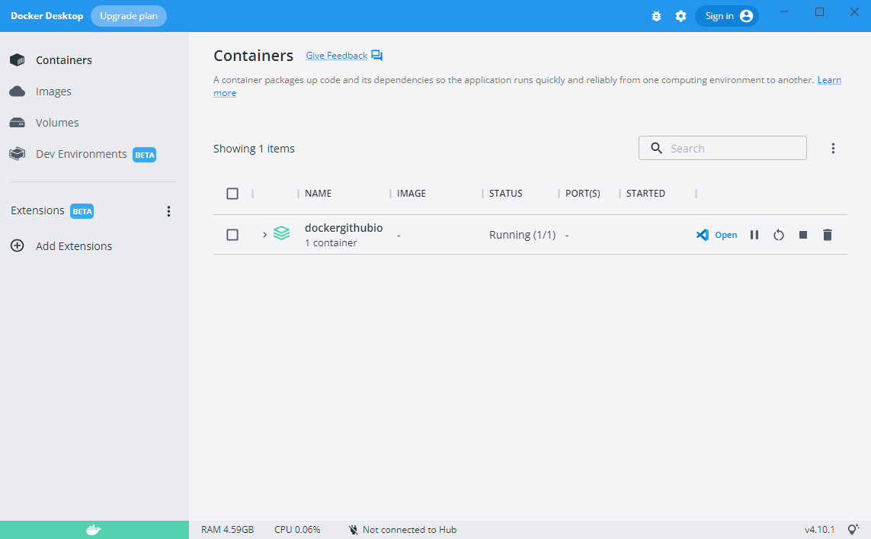
What do I need to use docker?
An image repository
Docker software
I use Docker hub.
I use Docker Desktop.
https://docs.docker.com/desktop/install/linux-install/

Slide 34
How do I make a Docker image?

Slide 35
How do I make a Docker image?
1. Make sure Docker desktop is running

Slide 36
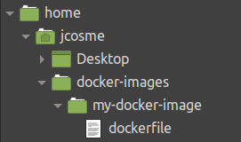
How do I make a Docker image?
1. Make sure Docker desktop is running

Slide 37
How do I make a Docker image?
1. Make sure Docker desktop is running
2. You’ll need a dedicated folder for your image

Slide 38
How do I make a Docker image?
1. Make sure Docker desktop is running
2. You’ll need a dedicated folder for your image
3. You’ll need a file called “dockerfile” inside the folder

Slide 39
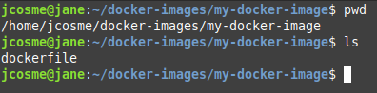
How do I make a Docker image?
1. Make sure Docker desktop is running
2. You’ll need a dedicated folder for your image
3. You’ll need a file called “dockerfile” inside the folder

Slide 40
How do I make a Docker image?
1. Make sure Docker desktop is running
2. You’ll need a dedicated folder for your image
3. You’ll need a file called “dockerfile” inside the folder
4. Navigate to the dedicated image folder in a terminal

Slide 41
How do I make a Docker image?
1. Make sure Docker desktop is running
2. You’ll need a dedicated folder for your image
3. You’ll need a file called “dockerfile” inside the folder
4. Navigate to the dedicated image folder in a terminal
5. Make sure the dockerfile is in the folder

Slide 42
How do I make a Docker image?
1. Make sure Docker desktop is running
2. You’ll need a dedicated folder for your image
3. You’ll need a file called “dockerfile” inside the folder
4. Navigate to the dedicated image folder in a terminal
5. Make sure the dockerfile is in the folder
6. Run this command to build
docker build -t {your-docker-hub-username}/{your-image-name}:{version-number} .

Slide 43
How do I make a Docker image?
1. Make sure Docker desktop is running
2. You’ll need a dedicated folder for your image
3. You’ll need a file called “dockerfile” inside the folder
4. Navigate to the dedicated image folder in a terminal
5. Make sure the dockerfile is in the folder
6. Run this command to build
docker build -t {your-docker-hub-username}/{your-image-name}:{version-number} .
(this is what my command be)
docker build -t jonathancosme/my-docker-image:1.0 .

Slide 44
How do I make a Docker image?
1. Make sure Docker desktop is running
2. You’ll need a dedicated folder for your image
3. You’ll need a file called “dockerfile” inside the folder
4. Navigate to the dedicated image folder in a terminal
5. Make sure the dockerfile is in the folder
6. Run this command to build
docker build -t {your-docker-hub-username}/{your-image-name}:{version-number} .
(this is what my command be)
docker build -t jonathancosme/my-docker-image:1.0 .
7. Run this to push to the repo
docker image push {your-docker-hub-username}/{your-image-name}:{version-number}

Slide 45
How do I make a Docker image?
1. Make sure Docker desktop is running
2. You’ll need a dedicated folder for your image
3. You’ll need a file called “dockerfile” inside the folder
4. Navigate to the dedicated image folder in a terminal
5. Make sure the dockerfile is in the folder
6. Run this command to build
docker build -t {your-docker-hub-username}/{your-image-name}:{version-number} .
(this is what my command be)
docker build -t jonathancosme/my-docker-image:1.0 .
7. Run this to push to the repo
docker image push {your-docker-hub-username}/{your-image-name}:{version-number}
(this is what my command be)
docker image push jonathancosme/my-docker-image:1.0

Slide 46
How I use my Docker image with run:ai?

Slide 47
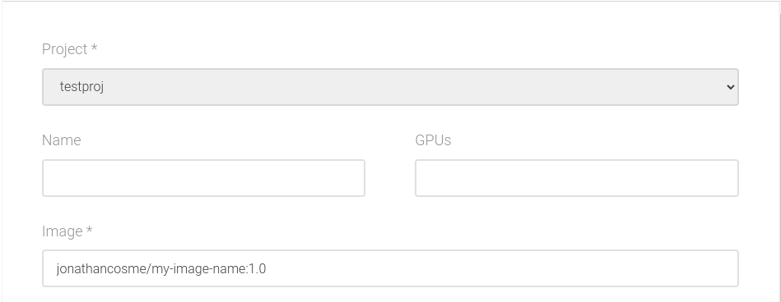
How I use my Docker image with run:ai?

Slide 48
How I use my Docker image with run:ai?
Enter the image name in the Image field of the UI

Slide 49
How I use my Docker image with run:ai?
Enter the image name in the Image field of the UI
runai submit -i jonathancosme/my-image-name:1.0 {other arguments}

Slide 50
How I use my Docker image with run:ai?
Enter the image name in the Image field of the UI
Use the -i flag on the CLI to specify the image
runai submit -i jonathancosme/my-image-name:1.0 {other arguments}

Slide 51
Dockerfile

Slide 52
What is a “dockerfile?”

Slide 53
What is a “dockerfile?”
A “dockerfile” is a simple text file that tells docker how to build your image.

Slide 54
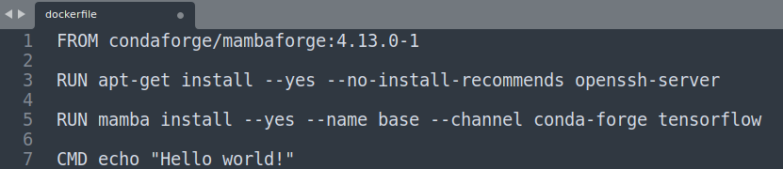
What is a “dockerfile?”
A “dockerfile” is a simple text file that tells docker how to build your image.

Slide 55
What is a “dockerfile?”
A “dockerfile” is a simple text file that tells docker how to build your image.
There are 3 basic commands to use

Slide 56
What is a “dockerfile?”
A “dockerfile” is a simple text file that tells docker how to build your image.
There are 3 basic commands to use
FROM - specifies the base image to use (a starting point)

Slide 57
What is a “dockerfile?”
A “dockerfile” is a simple text file that tells docker how to build your image.
There are 3 basic commands to use
FROM - specifies the base image to use (a starting point)
RUN - specifies a command to run in a terminal. This is used to install software.

Slide 58
What is a “dockerfile?”
A “dockerfile” is a simple text file that tells docker how to build your image.
There are 3 basic commands to use
FROM - specifies the base image to use (a starting point)
RUN - specifies a command to run in a terminal. This is used to install software.
CMD - specified the default command for the image to run, if no command is specified.

Slide 59
What is a “dockerfile?”
A “dockerfile” is a simple text file that tells docker how to build your image.
There are 3 basic commands to use
FROM - specifies the base image to use (a starting point)
RUN - specifies a command to run in a terminal. This is used to install software.
CMD - specified the default command for the image to run, if no command is specified.
(yes, these are case-sensitive, and must always be in caps)

Slide 60
What is a “dockerfile?”
A “dockerfile” is a simple text file that tells docker how to build your image.
There are 3 basic commands to use
FROM - specifies the base image to use (a starting point)
RUN - specifies a command to run in a terminal. This is used to install software.
CMD - specified the default command for the image to run, if no command is specified.
(yes, these are case-sensitive, and must always be in caps)
A full list and explanation of the dockerfile commands can be found here:
https://docs.docker.com/engine/reference/builder/

Slide 61
What is a “dockerfile?”
In this particular image,

Slide 62
What is a “dockerfile?”
In this particular image,
1. We start with an image with conda and mamba preinstalled

Slide 63
What is a “dockerfile?”
In this particular image,
1. We start with an image with conda and mamba preinstalled
2. Install openssh-server

Slide 64
What is a “dockerfile?”
In this particular image,
1. We start with an image with conda and mamba preinstalled
2. Install openssh-server
3. Use mamba (version of conda written in C++, so it’s much faster) to install tensorflow

Slide 65
What is a “dockerfile?”
In this particular image,
1. We start with an image with conda and mamba preinstalled
2. Install openssh-server
4. Tell the image to print “Hello world!” if no command is given
3. Use mamba (version of conda written in C++, so it’s much faster) to install tensorflow

Slide 66
About “layers”

Slide 67
About “layers”

Slide 68
About “layers”
Every time a dockerfile command is used, a “layer” is created

Slide 69
About “layers”
Every time a dockerfile command is used, a “layer” is created
This image has at least 4 layers.

Slide 70
About “layers”
Every time a dockerfile command is used, a “layer” is created
This image has at least 4 layers.
Keep in mind that the base image (FROM command) also has layers, so our layers will be built on top of these.

Slide 71
About “layers”
Every time a dockerfile command is used, a “layer” is created
This image has at least 4 layers.
Keep in mind that the base image (FROM command) also has layers, so our layers will be built on top of these.
Essentially, we will have number-of-layers-in-base-image + 3 layers.

Slide 72
About “layers”
All else equal, more layers make the image larger.

Slide 73
About “layers”
All else equal, more layers make the image larger.
As a general rule, we want images to be small.

Slide 74
About “layers”
All else equal, more layers make the image larger.
As a general rule, we want images to be small.
Pay attention to how you create your layers

Slide 75
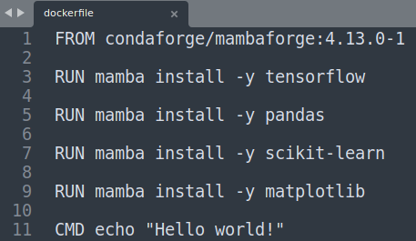
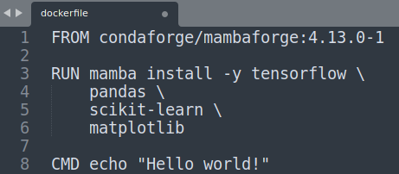
About “layers”
All else equal, more layers make the image larger.
As a general rule, we want images to be small.
Pay attention to how you create your layers

Slide 76
About “layers”
All else equal, more layers make the image larger.
As a general rule, we want images to be small.
Pay attention to how you create your layers

Slide 77


About “layers”
All else equal, more layers make the image larger.
As a general rule, we want images to be small.
Pay attention to how you create your layers

Slide 78
About “layers”
All else equal, more layers make the image larger.
As a general rule, we want images to be small.
Pay attention to how you create your layers
When you create a layer, it should accomplish a specific task, rather than installing one software package

Slide 79
About “layers”
When building images, docker will “cache” layers that have not changed; this makes building faster.

Slide 80
About “layers”
When building images, docker will “cache” layers that have not changed; this makes building faster.
If a layer is changed, all layers after it will need to be re-built.

Slide 81
About “layers”
When building images, docker will “cache” layers that have not changed; this makes building faster.
If a layer is changed, all layers after it will need to be re-built.
You want to structure your layers so that the most-often change layers are at bottom

Slide 82
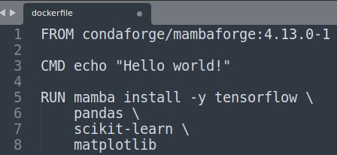
About “layers”
When building images, docker will “cache” layers that have not changed; this makes building faster.
If a layer is changed, all layers after it will need to be re-built.
You want to structure your layers so that the most-often change layers are at bottom
Original

Slide 83
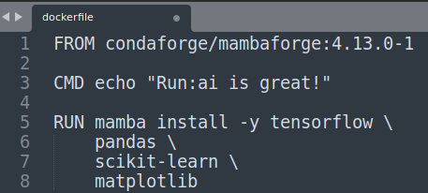
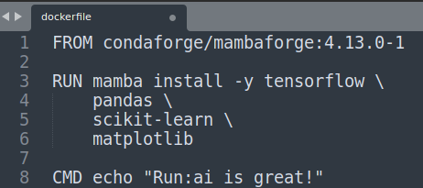
About “layers”
When building images, docker will “cache” layers that have not changed; this makes building faster.
If a layer is changed, all layers after it will need to be re-built.
You want to structure your layers so that the most-often change layers are at bottom
Original
Change

Slide 84
About “layers”
When building images, docker will “cache” layers that have not changed; this makes building faster.
If a layer is changed, all layers after it will need to be re-built.
You want to structure your layers so that the most-often change layers are at bottom
Original
Change
Rebuild layers

Slide 85
About “layers”
When building images, docker will “cache” layers that have not changed; this makes building faster.
If a layer is changed, all layers after it will need to be re-built.
You want to structure your layers so that the most-often change layers are at bottom
Original
Change
Rebuild layers

Slide 86
Docker images with Run:ai
(using Jupyter example)

Slide 87
Key concepts

Slide 88


Key concepts
1. Think of your software and your storage as separate

Slide 89

Key concepts
1. Think of your software and your storage as separate
2. Run:ai will take care of the hardware

Slide 90


Key concepts
1. Think of your software and your storage as separate
2. Run:ai will take care of the hardware
3. Your software will be put in containers (via Docker)

Slide 91


Key concepts
1. Think of your software and your storage as separate
2. Run:ai will take care of the hardware
3. Your software will be put in containers (via Docker)
4. Your code and data will be kept on the NFS

Slide 92
Key concepts
The idea is that you will mount your NFS, then run a script that is stored on the NFS

Slide 93
Jupyter

Slide 94
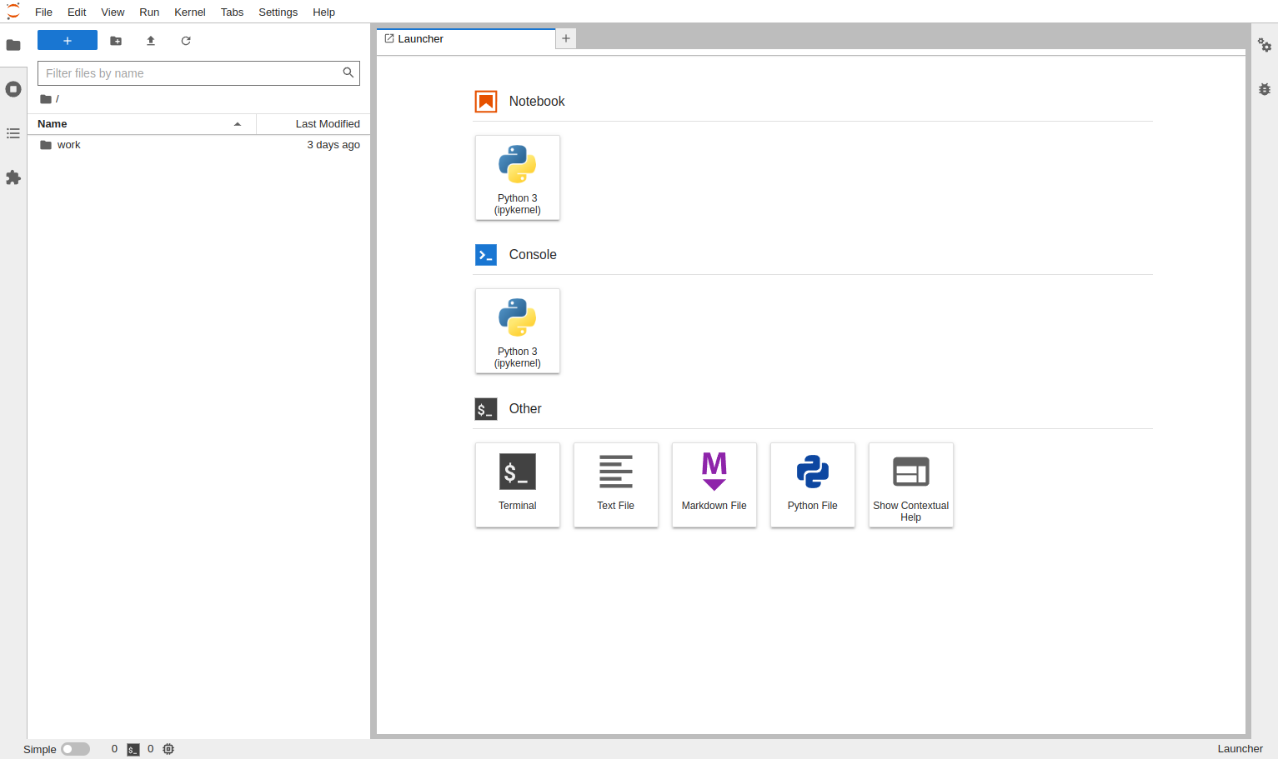
Jupyter
Jupyter Lab is a tool commonly used by data scientist.

Slide 95
Jupyter
Jupyter Lab is a tool commonly used by data scientist.
For our example, we will use an official image which can be pulled with:
jupyter/base-notebook

Slide 96
Jupyter on Run:ai

Slide 97
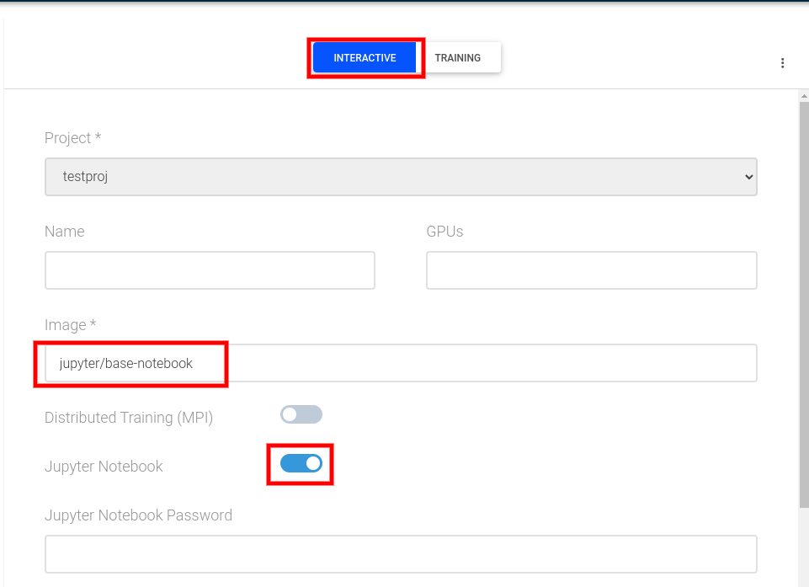
Jupyter on Run:ai
On the New Job UI:

Slide 98
Jupyter on Run:ai
On the New Job UI:
Select Interactive

Slide 99
Jupyter on Run:ai
On the New Job UI:
Select Interactive
Specify Image as jupyter/base-notebook

Slide 100
Jupyter on Run:ai
On the New Job UI:
Select Interactive
Specify Image as jupyter/base-notebook
Toggle the Jupyter Notebook option

Slide 101
Jupyter on Run:ai
On the New Job UI:
Select Interactive
Specify Image as jupyter/base-notebook
Toggle the Jupyter Notebook option
Submit the job

Slide 102
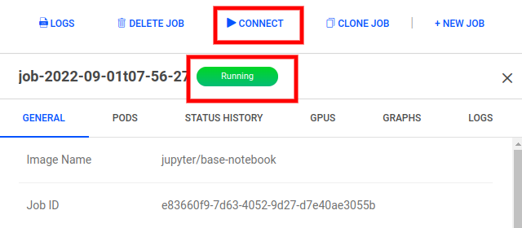
Jupyter on Run:ai
After the job status changes to Running, you can connect to the Jupyter Lab UI.

Slide 103
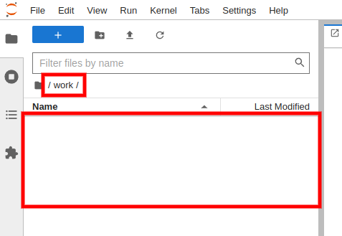
Jupyter on Run:ai
After the job status changes to Running, you can connect to the Jupyter Lab UI.
If you navigate to the work folder, you’ll notice it’s empty.

Slide 104
Jupyter on Run:ai with mounted NFS

Slide 105
Jupyter on Run:ai with mounted NFS
We’ll start with the same options as before…

Slide 106
Jupyter on Run:ai with mounted NFS
We’ll start with the same options as before…
On the New Job UI:
Select Interactive
Specify Image as jupyter/base-notebook
Toggle the Jupyter Notebook option

Slide 107
Jupyter on Run:ai with mounted NFS
We’ll start with the same options as before…
… but this time, we’ll mount our NFS folder to the “work” directory.
On the New Job UI:
Select Interactive
Specify Image as jupyter/base-notebook
Toggle the Jupyter Notebook option

Slide 108
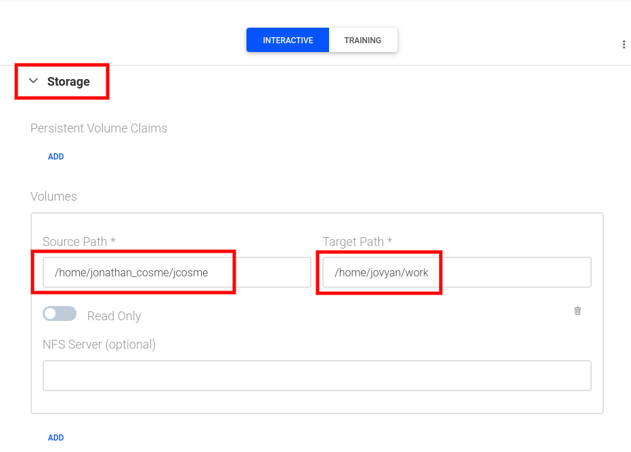
Jupyter on Run:ai with mounted NFS
We’ll start with the same options as before…
… but this time, we’ll mount our NFS folder to the “work” directory.
On the New Job UI:
Select Interactive
Specify Image as jupyter/base-notebook
Toggle the Jupyter Notebook option
Under Storage, select Add volume

Slide 109
Jupyter on Run:ai with mounted NFS
We’ll start with the same options as before…
… but this time, we’ll mount our NFS folder to the “work” directory.
On the New Job UI:
Select Interactive
Specify Image as jupyter/base-notebook
Toggle the Jupyter Notebook option
Under Storage, select Add volume
Input your NFS directory into the Source Path

Slide 110
Jupyter on Run:ai with mounted NFS
We’ll start with the same options as before…
… but this time, we’ll mount our NFS folder to the “work” directory.
On the New Job UI:
Select Interactive
Specify Image as jupyter/base-notebook
Toggle the Jupyter Notebook option
Under Storage, select Add volume
Input your NFS directory into the Source Path
Input /home/jovyan/work into the Target Path

Slide 111
Jupyter on Run:ai with mounted NFS
After the job status changes to Running, you can connect to the Jupyter Lab UI.

Slide 112
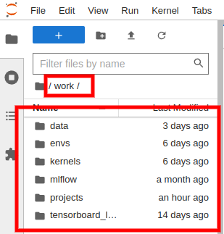
Jupyter on Run:ai with mounted NFS
After the job status changes to Running, you can connect to the Jupyter Lab UI.
If you navigate to the work folder, you’ll notice that all our files and folder are there

Slide 113
Docker image with non-interactive jobs

Slide 114
Running a non-interactive job

Slide 115
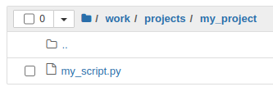
Running a non-interactive job
Lets say that I had a script called my_script.py

Slide 116
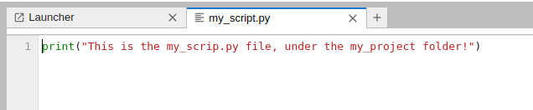
Running a non-interactive job
Lets say that I had a script called my_script.py
This is the content of the python script:

Slide 117
Running a non-interactive job
In order to run the script using the image:

Slide 118
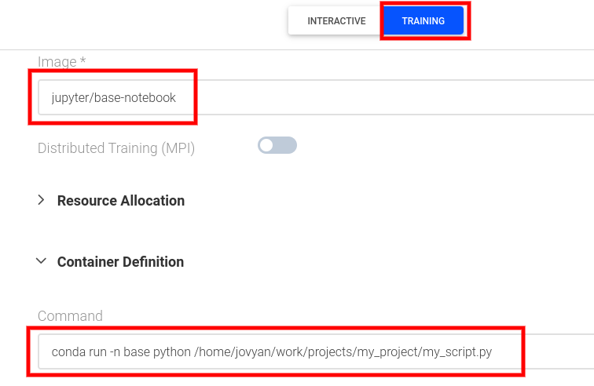
Running a non-interactive job
In order to run the script using the image:
Select Training type job
1

Slide 119
Running a non-interactive job
In order to run the script using the image:
Select Training type job
Specify the image as jupyter/base-notebook
1
2

Slide 120
Running a non-interactive job
In order to run the script using the image:
Select Training type job
Specify the image as jupyter/base-notebook
Mount your NFS volume
1
2
3

Slide 121
Running a non-interactive job
In order to run the script using the image:
Select Training type job
Specify the image as jupyter/base-notebook
Mount your NFS volume
Add a Command under Container Definition
1
2
3
4

Slide 122
Running a non-interactive job
In order to run the script using the image:
Select Training type job
Specify the image as jupyter/base-notebook
Mount your NFS volume
Add a Command under Container Definition
In Command, under Container Definition, input: conda run -n base python /home/jovyan/work/projects/my_project/my_script.py
1
2
3
4

Slide 123
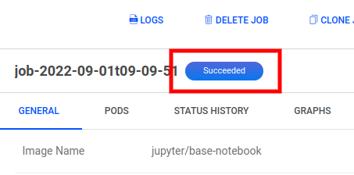
Running a non-interactive job
Wait for the job status to change to Succeeded

Slide 124
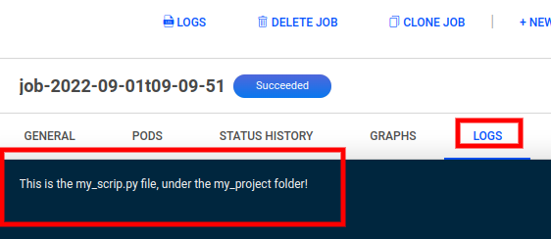
Running a non-interactive job
Wait for the job status to change to Succeeded
In the Logs tab, you should see the output of my_script.py

Slide 125
Closing notes

Slide 126
Closing notes

Slide 127
Closing notes
Some general Docker tips

Slide 128
Closing notes
Some general Docker tips
Use an official Docker image as a base image
- They are more stable

Slide 129
Closing notes
Some general Docker tips
Use an official Docker image as a base image
- They are more stable
Use a specific version (the more specific the better)
- If no version is specified Docker will just take the latest version, which could break your image

Slide 130
Closing notes
Some general Docker tips
Use an official Docker image as a base image
- They are more stable
Use a specific version (the more specific the better)
- If no version is specified Docker will just take the latest version, which could break your image
If starting with a raw OS image, selected an image with a lean distribution.
- For example, use Alpine over Ubuntu. Ubuntu contains a lot of software you won’t need.

Slide 131
Closing notes
Some general Docker tips
Use an official Docker image as a base image
- They are more stable
Use a specific version (the more specific the better)
- If no version is specified Docker will just take the latest version, which could break your image
If starting with a raw OS image, selected an image with a lean distribution.
- For example, use Alpine over Ubuntu. Ubuntu contains a lot of software you won’t need.
BE AWARE

Slide 132
Closing notes
Some general Docker tips
Use an official Docker image as a base image
- They are more stable
Use a specific version (the more specific the better)
- If no version is specified Docker will just take the latest version, which could break your image
If starting with a raw OS image, selected an image with a lean distribution.
- For example, use Alpine over Ubuntu. Ubuntu contains a lot of software you won’t need.
BE AWARE
ONLY THE CONTENT OF THE FOLDER CONTAINING YOUR NFS MOUNT WILL BE SAVED/PERSIST

Slide 133
Closing notes
Some general Docker tips
Use an official Docker image as a base image
- They are more stable
Use a specific version (the more specific the better)
- If no version is specified Docker will just take the latest version, which could break your image
If starting with a raw OS image, selected an image with a lean distribution.
- For example, use Alpine over Ubuntu. Ubuntu contains a lot of software you won’t need.
BE AWARE
ONLY THE CONTENT OF THE FOLDER CONTAINING YOUR NFS MOUNT WILL BE SAVED/PERSIST
- This means that ALL OTHER FILES that were created during the job session will be gone forever, once the job finishes

Slide 134
Closing notes
Some general Docker tips
Use an official Docker image as a base image
- They are more stable
Use a specific version (the more specific the better)
- If no version is specified Docker will just take the latest version, which could break your image
If starting with a raw OS image, selected an image with a lean distribution.
- For example, use Alpine over Ubuntu. Ubuntu contains a lot of software you won’t need.
BE AWARE
ONLY THE CONTENT OF THE FOLDER CONTAINING YOUR NFS MOUNT WILL BE SAVED/PERSIST
- This means that ALL OTHER FILES that were created during the job session will be gone forever, once the job finishes
ANY SOFTWARE CHANGES (using apt/apt-get install or conda/mamba install/create) made while the job is running WILL NOT BE SAVED

Slide 135
Closing notes
Some general Docker tips
Use an official Docker image as a base image
- They are more stable
Use a specific version (the more specific the better)
- If no version is specified Docker will just take the latest version, which could break your image
If starting with a raw OS image, selected an image with a lean distribution.
- For example, use Alpine over Ubuntu. Ubuntu contains a lot of software you won’t need.
BE AWARE
ONLY THE CONTENT OF THE FOLDER CONTAINING YOUR NFS MOUNT WILL BE SAVED/PERSIST
- This means that ALL OTHER FILES that were created during the job session will be gone forever, once the job finishes
ANY SOFTWARE CHANGES (using apt/apt-get install or conda/mamba install/create) made while the job is running WILL NOT BE SAVED
- If you want to make permanent software changes to the image, you will need to update the dockerfile, re-build it, and re-push it to Docker hub.

Slide 136
Thank you!

